Slide 1
Lecture 4
Unit Root Tests for Stationarity

Slide 2
Chapter Contents
12.1 Stationary and Nonstationary Variables
12.2 Spurious Regressions
12.3 Unit Root Tests for Nonstationarity

Slide 3
The aim is to describe how to estimate regression models involving nonstationary variables
The first step is to examine the time-series concepts of stationarity (and nonstationarity) and how we distinguish between them.
Cointegration is another important related concept that has a bearing on our choice of a regression model

Slide 4
12.1
Stationary and Nonstationary Variables

Slide 5
12.1
Stationary and Nonstationary Variables
The change in a variable is an important concept
The change in a variable y_{t}, also known as its first difference, is given by Δy_{t =} y_{t} – y_{t-1}.
Δy_{t} is the change in the value of the variable y from period t - 1 to period t

Slide 6
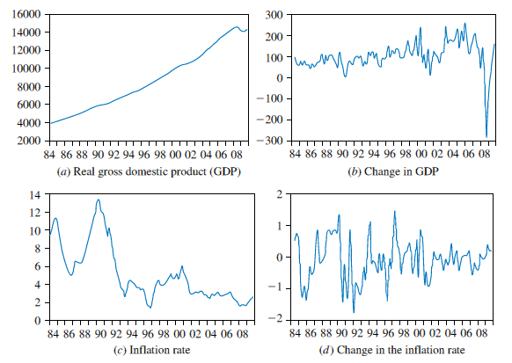
12.1
Stationary and Nonstationary Variables
FIGURE 12.1 U.S. economic time series

Slide 7
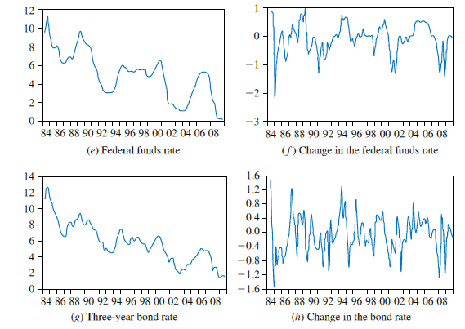
12.1
Stationary and Nonstationary Variables
FIGURE 12.1 (Continued) U.S. economic time series

Slide 8
12.1
Stationary and Nonstationary Variables
Formally, a time series y_{t} is stationary if its mean and variance are constant over time, and if the covariance between two values from the series depends only on the length of time separating the two values, and not on the actual times at which the variables are observed

Slide 9
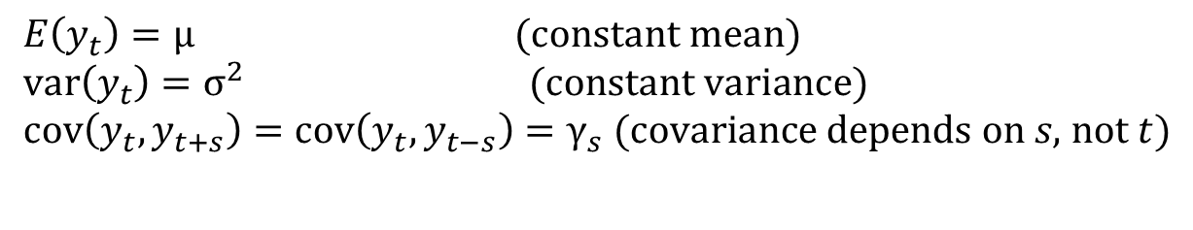
12.1
Stationary and Nonstationary Variables
That is, the time series y_{t} is stationary if for all values, and every time period, it is true that:
Eq. 12.1a
$$E\left(y_{t}\right)=\text{μ} (\text{constant} \text{mean}) \\ \text{var}\left(y_{t}\right)=σ^{2} (\text{constant} \text{variance}) \\ \text{cov}\left(y_{t},y_{t+s}\right)=\text{cov}\left(y_{t},y_{t−s}\right)=γ_{s} (\text{covariance} \text{depends} \text{on} s\text{, }\text{not} t)$$
Eq. 12.1b
Eq. 12.1c

Slide 10
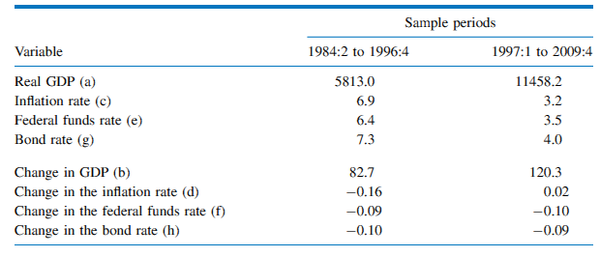
12.1
Stationary and Nonstationary Variables
Table 12.1 Sample Means of Time Series Shown in Figure 12.1

Slide 11


12.1
Stationary and Nonstationary Variables
12.1.1
The First-Order Autoregressive Model
The autoregressive model of order one, the AR(1) model, is a useful univariate time series model for explaining the difference between stationary and nonstationary series:
The errors v_{t} are independent, with zero mean and constant variance , and may be normally distributed
The errors are sometimes known as ‘‘shocks’’ or ‘‘innovations’’
Eq. 12.2a
$$y_{t}=ρy_{t−1}+v_{t}, \left|ρ\right|<1$$
$$σ_{v}^{2}$$

Slide 12
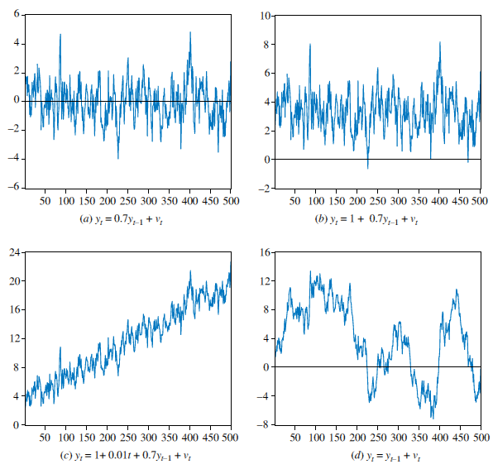
12.1
Stationary and Nonstationary Variables
FIGURE 12.2 Time-series models
12.1.1
The First-Order Autoregressive Model

Slide 13
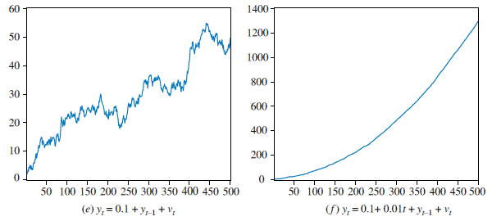
12.1
Stationary and Nonstationary Variables
FIGURE 12.2 (Continued) Time-series models
12.1.1
The First-Order Autoregressive Model

Slide 14


12.1
Stationary and Nonstationary Variables
12.1.1
The First-Order Autoregressive Model
Real-world data rarely have a zero mean
We can introduce a nonzero mean μ as:
Or
$$(y_{t}−μ)=ρ(y_{t−1}−μ)+v_{t}$$
$$y_{t}=α+ρ​y_{t−1}+v_{t}, \left|ρ\right|<1$$
Eq. 12.2b

Slide 15
12.1
Stationary and Nonstationary Variables
12.1.1
The First-Order Autoregressive Model
With α = 1 and ρ = 0.7:
$$E(y_{t})=μ=α/(1−ρ)=1/(1−0.7)=3.33$$

Slide 16

12.1
Stationary and Nonstationary Variables
12.1.1
The First-Order Autoregressive Model
An extension to Eq. 12.2a is to consider an AR(1) model fluctuating around a linear trend: (μ + δt)
Let the ‘‘de-trended’’ series (y_{t} -μ - δt) behave like an autoregressive model:
Or:
$$(y_{t}−μ−δt)=ρ(y_{t−1}−μ−δ(t−1))+v_{t}, \left|ρ\right|<1$$
Eq. 12.2c
$$y_{t}=α+ρy_{t−1}+λt+v_{t}$$

Slide 17

12.1
Stationary and Nonstationary Variables
12.1.2
Random Walk Models
Consider the special case of ρ = 1:
This model is known as the random walk model
These time series are called random walks because they appear to wander slowly upward or downward with no real pattern
the values of sample means calculated from subsamples of observations will be dependent on the sample period
This is a characteristic of nonstationary series
Eq. 12.3a
$$y_{t}=y_{t−1}+v_{t}$$

Slide 18

12.1
Stationary and Nonstationary Variables
12.1.2
Random Walk Models
We can understand the ‘‘wandering’’ by recursive substitution:
$$y_{1}=y_{0}+v_{1} \\ y_{2}=y_{1}+v_{2}=(y_{0}+v_{1})+v_{2}=y_{0}+\sum_{s=1}^{2}{v_{s}} \\ ⋮ \\ y_{t}=y_{t−1}+v_{t}=y_{0}+\sum_{s=1}^{t}{v_{s}}$$

Slide 19

12.1
Stationary and Nonstationary Variables
12.1.2
Random Walk Models
The term is often called the stochastic trend
This term arises because a stochastic component v_{t} is added for each time t, and because it causes the time series to trend in unpredictable directions
$$\sum_{s=1}^{t}{v_{s}}$$

Slide 20


12.1
Stationary and Nonstationary Variables
12.1.2
Random Walk Models
Recognizing that the v_{t} are independent, taking the expectation and the variance of y_{t} yields, for a fixed initial value y₀:
The random walk has a mean equal to its initial value and a variance that increases over time, eventually becoming infinite
$$E(y_{t})=y_{0}+E(v_{1}+v_{2}+...+v_{t})=y_{0}$$
$$\operatorname{var}{(}y_{t})=\operatorname{var}{(}v_{1}+v_{2}+...+v_{t})=tσ_{v}^{2}$$

Slide 21

12.1
Stationary and Nonstationary Variables
12.1.2
Random Walk Models
Another nonstationary model is obtained by adding a constant term:
This model is known as the random walk with drift
Eq. 12.3b
$$y_{t}=α+y_{t−1}+v_{t}$$

Slide 22

12.1
Stationary and Nonstationary Variables
12.1.2
Random Walk Models
A better understanding is obtained by applying recursive substitution:
$$y_{1}=α+y_{0}+v_{1} \\ y_{2}=α+y_{1}+v_{2}=α+(α+y_{0}+v_{1})+v_{2}=2α+y_{0}+\sum_{s=1}^{2}{v_{s}} \\ ⋮ \\ y_{t}=α+y_{t−1}+v_{t}=tα+y_{0}+\sum_{s=1}^{t}{v_{s}}$$

Slide 23
12.1
Stationary and Nonstationary Variables
12.1.2
Random Walk Models
The term tα a deterministic trend component
It is called a deterministic trend because a fixed value α is added for each time t
The variable y wanders up and down as well as increases by a fixed amount at each time t

Slide 24
12.1
Stationary and Nonstationary Variables
12.1.2
Random Walk Models
The mean and variance of y_{t} are:
$$E(y_{t})=tα+y_{0}+E(v_{1}+v_{2}+v_{3}+...+v_{t})=tα+y_{0}$$
$$\operatorname{var}{(}y_{t})=\operatorname{var}{(}v_{1}+v_{2}+v_{3}+...+v_{t})=tσ_{v}^{2}$$

Slide 25

12.1
Stationary and Nonstationary Variables
12.1.2
Random Walk Models
We can extend the random walk model even further by adding a time trend:
Eq. 12.3c
$$y_{t}=α+δt+y_{t−1}+v_{t}$$

Slide 26
12.2
Spurious Regressions

Slide 27
12.2
Spurious Regressions
The main reason why it is important to know whether a time series is stationary or nonstationary before one embarks on a regression analysis is that there is a danger of obtaining apparently significant regression results from unrelated data when nonstationary series are used in regression analysis
Such regressions are said to be spurious

Slide 28
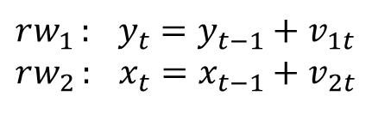
12.2
Spurious Regressions
Consider two independent random walks:
These series were generated independently and, in truth, have no relation to one another
Yet when plotted we see a positive relationship between them
$$rw_{1}:{ } y_{t}=y_{t−1}+v_{1t} \\ rw_{2}:{ } x_{t}=x_{t−1}+v_{2t}$$

Slide 29
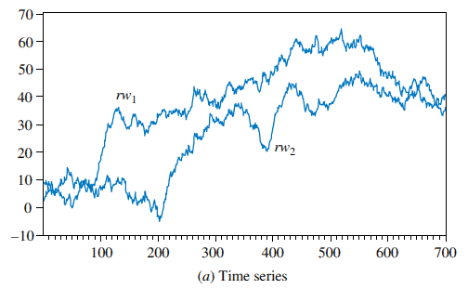
12.2
Spurious Regressions
FIGURE 12.3 Time series and scatter plot of two random walk variables

Slide 30
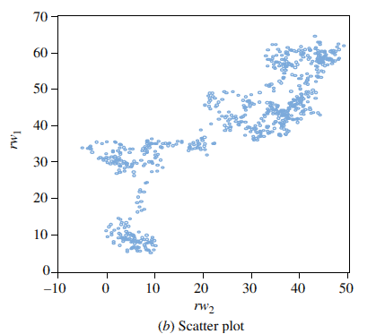
12.2
Spurious Regressions
FIGURE 12.3 (Continued) Time series and scatter plot of two random walk variables

Slide 31
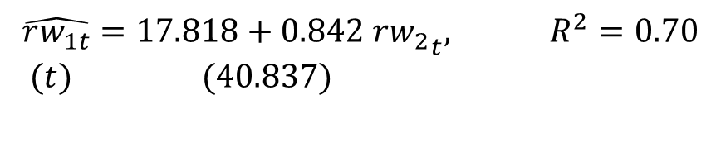
12.2
Spurious Regressions
A simple regression of series one (rw₁) on series two (rw₂) yields:
These results are completely meaningless, or spurious
The apparent significance of the relationship is false
$$\hat{rw_{1t}}=17.818+0.842 r{w_{2}}_{t}, R^{2}=0.70 \\ (t) (40.837)$$

Slide 32
12.2
Spurious Regressions
When nonstationary time series are used in a regression model, the results may spuriously indicate a significant relationship when there is none
In these cases the least squares estimator and least squares predictor do not have their usual properties, and t-statistics are not reliable
Since many macroeconomic time series are nonstationary, it is particularly important to take care when estimating regressions with macroeconomic variables

Slide 33
12.3
Unit Root Tests for Stationarity

Slide 34
12.3
Unit Root Tests for Stationarity
There are many tests for determining whether a series is stationary or nonstationary
The most popular is the Dickey–Fuller test

Slide 35
12.3
Unit Root Tests for Stationarity
12.3.1
Dickey-Fuller Test 1 (No constant and No Trend)
The AR(1) process y_{t} = ρy_{t-1} + v_{t} is stationary when |ρ| < 1
But, when ρ = 1, it becomes the nonstationary random walk process
We want to test whether ρ is equal to one or significantly less than one
Tests for this purpose are known as unit root tests for stationarity

Slide 36

12.3
Unit Root Tests for Stationarity
12.3.1
Dickey-Fuller Test 1 (No constant and No Trend)
Consider again the AR(1) model:
We can test for nonstationarity by testing the null hypothesis that ρ = 1 against the alternative that |ρ| < 1
Or simply ρ < 1
Eq. 12.4
$$y_{t}=ρy_{t−1}+v_{t}$$

Slide 37


12.3
Unit Root Tests for Stationarity
12.3.1
Dickey-Fuller Test 1 (No constant and No Trend)
A more convenient form is:
The hypotheses are:
$$y_{t}−y_{t−1}=ρy_{t−1}−y_{t−1}+v_{t} \\ Δy_{t}=\left(ρ−1\right)y_{t−1}+v_{t} \\ =γ​y_{t−1}+v_{t}$$
Eq. 12.5a
$$H_{0}:{ρ}=1 ⇔ H_{0}:{γ}=0 \\ H_{1}:{ρ}<1 ⇔ H_{1}:{γ}<0$$

Slide 38

12.3
Unit Root Tests for Stationarity
12.3.2
Dickey-Fuller Test 2 (With Constant but No Trend)
The second Dickey–Fuller test includes a constant term in the test equation:
The null and alternative hypotheses are the same as before
Eq. 12.5b
$$Δy_{t}=α+γ​y_{t−1}+v_{t}$$

Slide 39

12.3
Unit Root Tests for Stationarity
12.3.3
Dickey-Fuller Test 3 (With Constant and With Trend)
The third Dickey–Fuller test includes a constant and a trend in the test equation:
The null and alternative hypotheses are H₀: γ = 0 and H₁:γ < 0 (same as before)
Eq. 12.5c
$$Δy_{t}=α+γy_{t−1}+λt+v_{t}$$

Slide 40
12.3
Unit Root Tests for Stationarity
12.3.4
The Dickey-Fuller Critical Values
To test the hypothesis in all three cases, we simply estimate the test equation by least squares and examine the t-statistic for the hypothesis that γ = 0
Unfortunately this t-statistic no longer has the t-distribution
Instead, we use the statistic often called a τ (tau) statistic

Slide 41
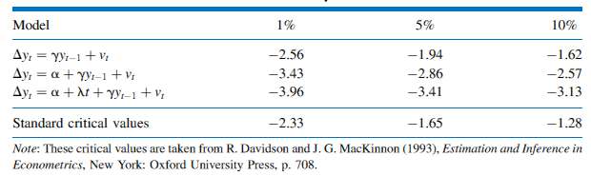
12.3
Unit Root Tests for Stationarity
Table 12.2 Critical Values for the Dickey–Fuller Test
12.3.4
The Dickey-Fuller Critical Values

Slide 42
12.3
Unit Root Tests for Stationarity
12.3.4
The Dickey-Fuller Critical Values
To carry out a one-tail test of significance, if τ_{c} is the critical value obtained from Table 12.2, we reject the null hypothesis of nonstationarity if τ ≤ τ_{c}
If τ > τ_{c} then we do not reject the null hypothesis that the series is nonstationary

Slide 43
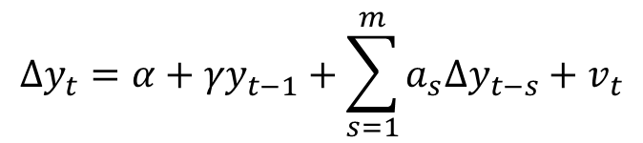
12.3
Unit Root Tests for Stationarity
12.3.4
The Dickey-Fuller Critical Values
An important extension of the Dickey–Fuller test allows for the possibility that the error term is autocorrelated
Consider the model:
where
$$Δy_{t}=α+γ​y_{t−1}+\sum_{s=1}^{m}{a_{s}Δy_{t−s}}+v_{t}$$
Eq. 12.6
$$Δy_{t−1}=\left(y_{t−1}−y_{t−2}\right), Δy_{t−2}=\left(y_{t−2}−y_{t−3}\right), …$$

Slide 44
12.3
Unit Root Tests for Stationarity
12.3.4
The Dickey-Fuller Critical Values
The unit root tests based on Eq. 12.6 and its variants (intercept excluded or trend included) are referred to as augmented Dickey–Fuller tests
When γ = 0, in addition to saying that the series is nonstationary, we also say the series has a unit root
In practice, we always use the augmented Dickey–Fuller test

Slide 45
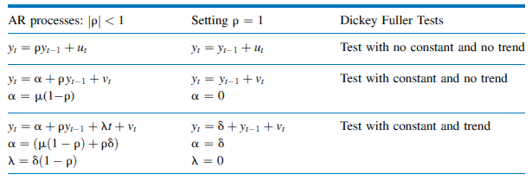
12.3
Unit Root Tests for Stationarity
Table 12.3 AR processes and the Dickey-Fuller Tests
12.3.5
The Dickey-Fuller Testing Procedures

Slide 46
12.3
Unit Root Tests for Stationarity
12.3.5
The Dickey-Fuller Testing Procedures
The Dickey-Fuller testing procedure:
First plot the time series of the variable and select a suitable Dickey-Fuller test based on a visual inspection of the plot
If the series appears to be wandering or fluctuating around a sample average of zero, use test equation (12.5a)
If the series appears to be wandering or fluctuating around a sample average which is nonzero, use test equation (12.5b)
If the series appears to be wandering or fluctuating around a linear trend, use test equation (12.5c)

Slide 47
12.3
Unit Root Tests for Stationarity
12.3.6
The Dickey-Fuller Tests: An Example
As an example, consider the two interest rate series:
The federal funds rate (F_{t})
The three-year bond rate (B_{t})
Following procedures described in Sections 12.3 and 12.4, we find that the inclusion of one lagged difference term is sufficient to eliminate autocorrelation in the residuals in both cases

Slide 48

12.3
Unit Root Tests for Stationarity
12.3.6
The Dickey-Fuller Tests: An Example
The results from estimating the resulting equations are:
The 5% critical value for tau (τ_{c}) is -2.86
Since -2.505 > -2.86, we do not reject the null hypothesis of non-stationarity.
$$\hat{ΔF_{t}}=0.173−0.045F_{t−1}+0.561ΔF_{t−1} \\ (tau) (−2\text{.505})$$ $$\hat{ΔB_{t}}=0.237−0.056B_{t−1}+0.237ΔB_{t−1} \\ (tau) (−2\text{.703})$$

Slide 49

12.3
Unit Root Tests for Stationarity
12.3.7
Order of Integration
Recall that if y_{t} follows a random walk, then γ = 0 and the first difference of y_{t} becomes:
Series like y_{t}, which can be made stationary by taking the first difference, are said to be integrated of order one, and denoted as I(1)
Stationary series are said to be integrated of order zero, I(0)
In general, the order of integration of a series is the minimum number of times it must be differenced to make it stationary
$$Δy_{t}=y_{t}−y_{t−1}=v_{t}$$

Slide 50
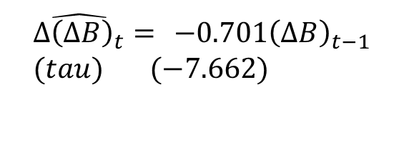

12.3
Unit Root Tests for Stationarity
12.3.7
Order of Integration
The results of the Dickey–Fuller test for a random walk applied to the first differences are:
$$\hat{Δ{\left(ΔF\right)}_{t}}= −0.447{\left(ΔF\right)}_{t−1} \\ (tau) (−5.487)$$
$$\hat{Δ{\left(ΔB\right)}_{t}}= −0.701{\left(ΔB\right)}_{t−1} \\ (tau) (−7.662)$$

Slide 51
12.3
Unit Root Tests for Stationarity
12.3.7
Order of Integration
Based on the large negative value of the tau statistic (-5.487 < -1.94), we reject the null hypothesis that ΔF_{t} is nonstationary and accept the alternative that it is stationary
We similarly conclude that ΔB_{t} is stationary (-7.662 < -1.94)

